Slide 1

Public Opinions
Hasan Muhammad Baniamin

Slide 2
Public
Gabriel Almond’s three public:
  1. A general public of a majority that does not know or care about much beyond their immediate concerns. For example, they show little interest in foreign policy unless the country is in a war or international crisis.
  2. An attentive public of a minority who are among the better educated and who follow more abstract political concerns, such as foreign policy. They are the audience the elite plays to; in turn, this attentive public passes on views that mobilize the general public.
  3. A policy and opinion elite of a few highly influential people who are involved in politics, often professionally. These people include civil society members, cultural elite and top journalists.

Slide 3
What is Public Opinion?
The aggregation of people’s views about issues, situations, and public figures
polls
  brief snapshot of feelings on a specific issue
surveys
  broad; usually done by trusted institution

Slide 4
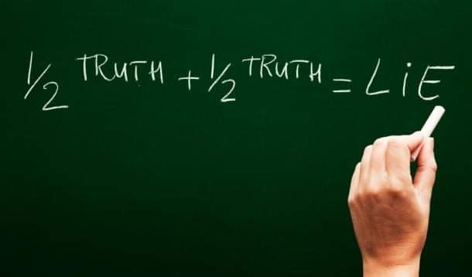

Slide 5
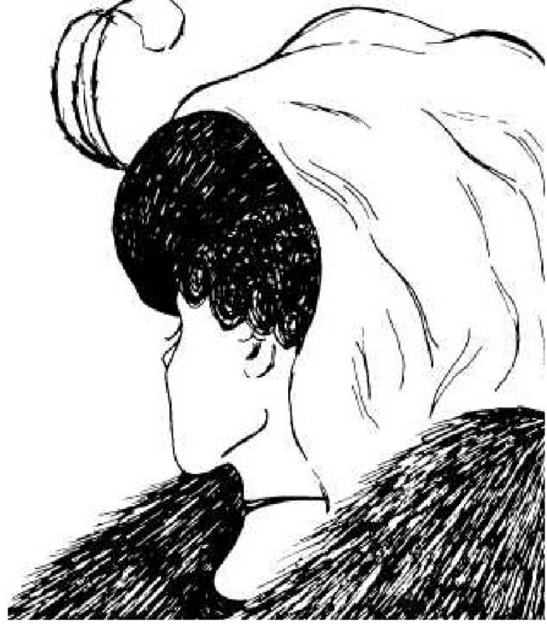
Ambiguity

Slide 6
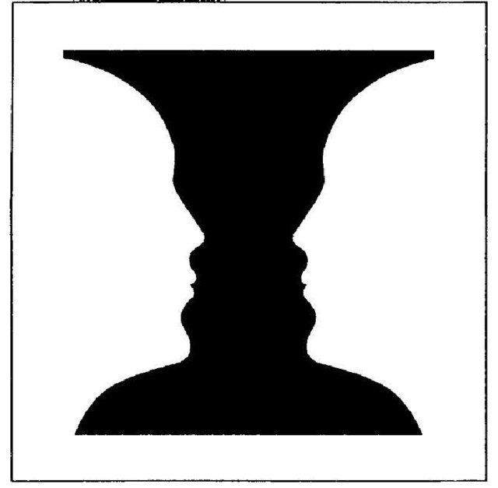
Ambiguity

Slide 7
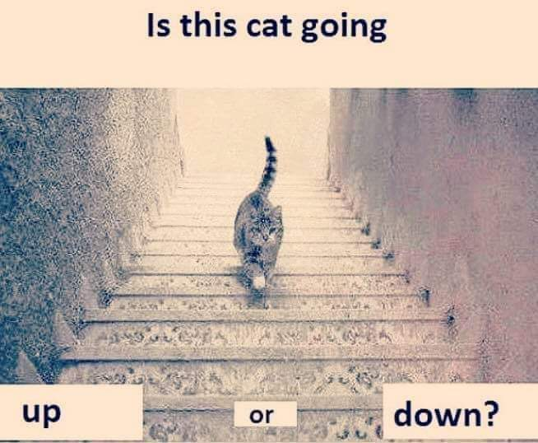
Ambiguity

Slide 8
Evaluation processes
Daniel Kahneman-Thinking, Fast and Slow
  System 1:
    Fast, automatic, emotional, stereotypic, unconscious.
    Most of public opinions reflect system 1 based opinions.
  System 2:
    Slow, effortful, logical, calculating, conscious.
    People are lazy to use this effortful system

Slide 9
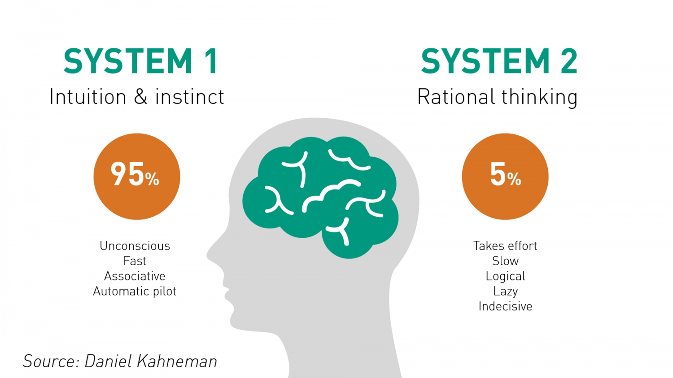

Slide 10
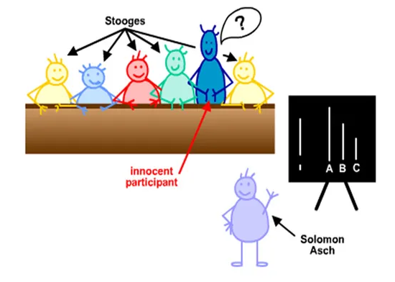

Slide 11
System 1 works based on different biases
Conformity Bias- when ones views are swayed too much by other.

Slide 12
Where do our Attitudes Come From?
The Family
Peers
Education
Group differences:
  Age
  Tribe
  Religion
  Social class

Slide 13
Why is Public Opinion Important?
Can help provide:
  legitimacy- higher approval rating = more legitimacy for policy/initiatives
  accountability- help politicians gauge how the public feels about them
  input in the policy-making process- policy-makers responsive to public

Slide 14
Public opinions and public policy
A public policy is any decision or action by a governmental authority that results in the allocation of something that is valued.
In democratic context, public opinion significantly contributes to shape public policy.

Slide 15
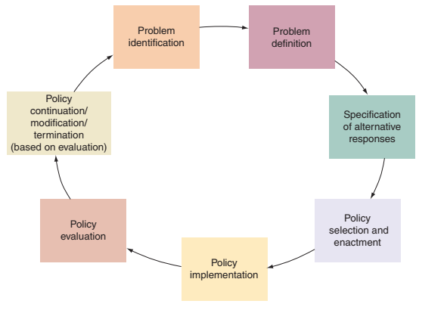
States of public policy

Slide 16
Stages of public policy and public opinion
1.Problem identification – based on public demand, policy makers may consider some issues or may drop some issues for further actions.
2. Problem definition- what seem to be the causes of the problem, and to define desired outcomes. Public opinion shapes these definitions.
3. Specification of alternatives: at this state alternatives are identified to addresses the problem.

Slide 17
Stages of public policy and public opinion
4.Policy Selection- try to assess the possible cost and benefits from the options and select the best suitable option. During this cost-benefit analysis, citizens concerned contribute a significant role. For example- Coal mining.
5.Implementation- for many policies, people and their opinions are considered to increase the legitimacy and the effectiveness of the policy.
6.Evaluation- as a main stakeholder of public policy, citizens’ feedback is always an important defining factor.

Slide 18
What do think?
Corruption and voting?

Slide 19
How voters decide: Three theories
Economic model/Rational choice model: benefits of voting-preferred policy enacted.
Psychological model: psychological attachment to one party.
Sociological model: stress the group basis of voting. Example: voting based on tribe.

Slide 20
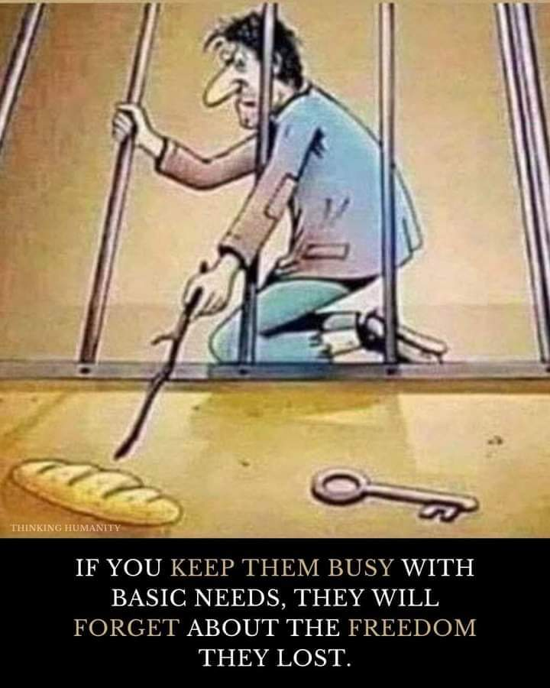

Slide 21
Public opinion and online platform
Use of social media to expose corruption- going ‘viral’ has huge effect.
‘Echo chambers’ creates a situation where like-minded people reinforce each other’s opinion, but do not get exposed to the views of the opposing side.
Fake news, bot, social media algorithms are further enforcing the problem .
Different biases-
  Confirmation Bias- refers to how people primarily search for bits of evidence that back up their opinions.
  Attribution bias or self-serving bias (We generally attribute our own accomplishments to our skill and personality, and our failures to external factors)
  Coverage Bias- it is a form of media bias where certain politicians or topics are disproportionately covered

Slide 22
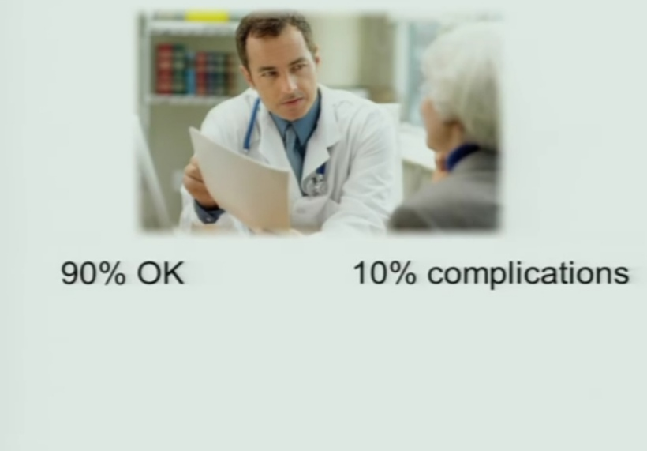
What do you think?

Slide 23
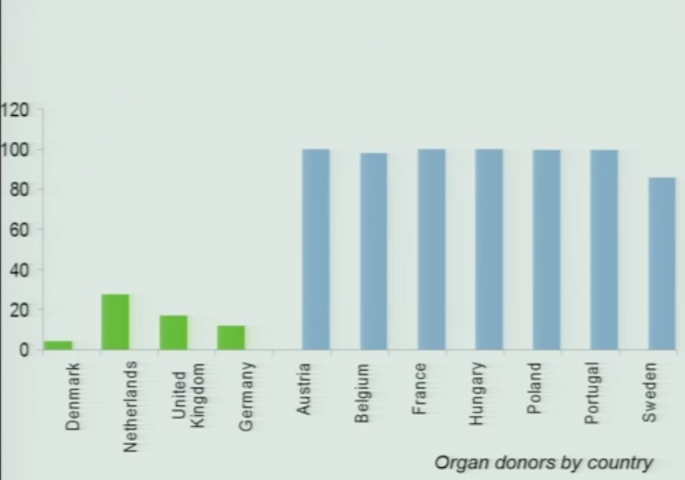
Nudges

Slide 24

Nudges

Slide 25
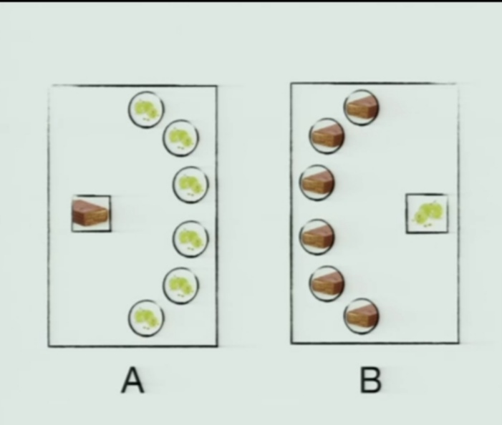
Nudges

Slide 26
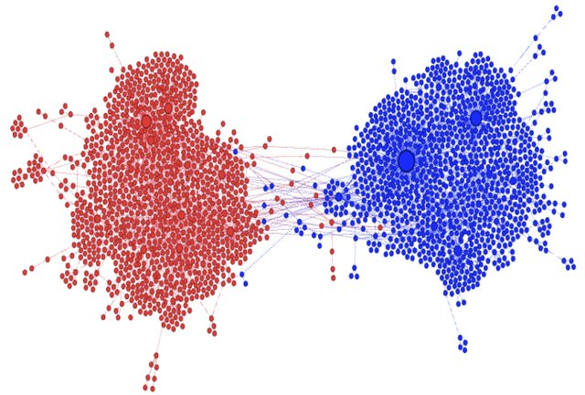
Echo-chamber formation
Page <number>
Source: Kumar et al., 2018

Slide 27
Public opinion and online platform
Defining our political reality and creating distrust
Populism, Trump, Brexit
    Brexit referendum : UK sends £350m a week to the EU
    '#IAmHere‘ campaign: people trying to make Facebook a nicer place

Slide 28
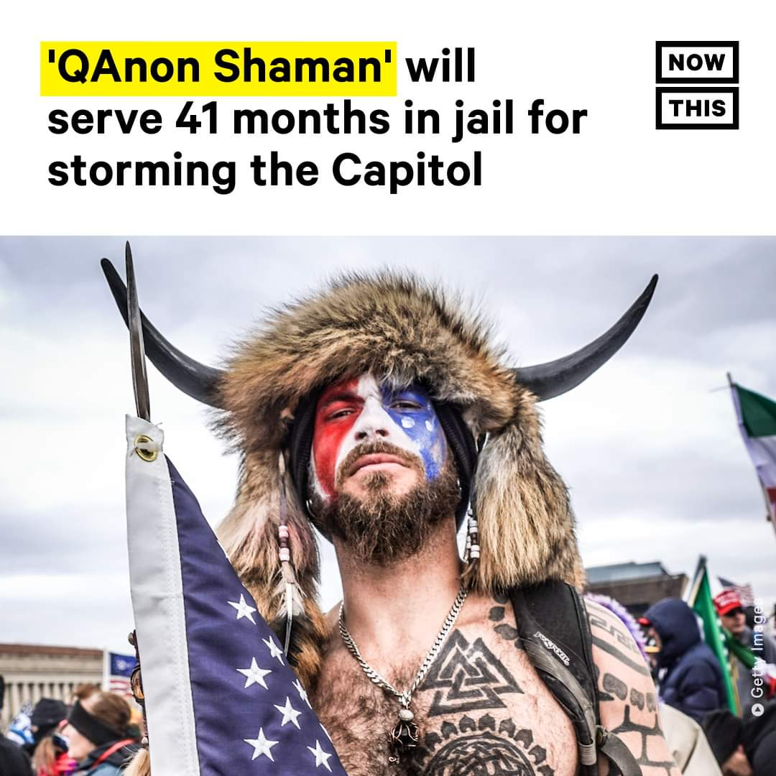

Slide 29
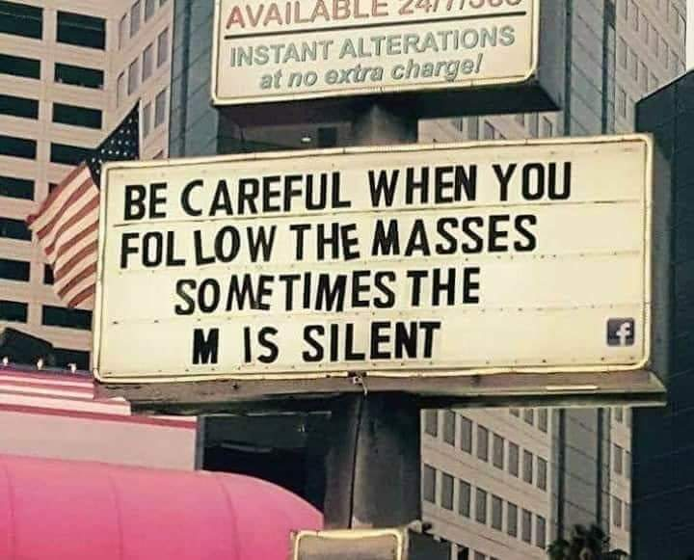

Slide 30
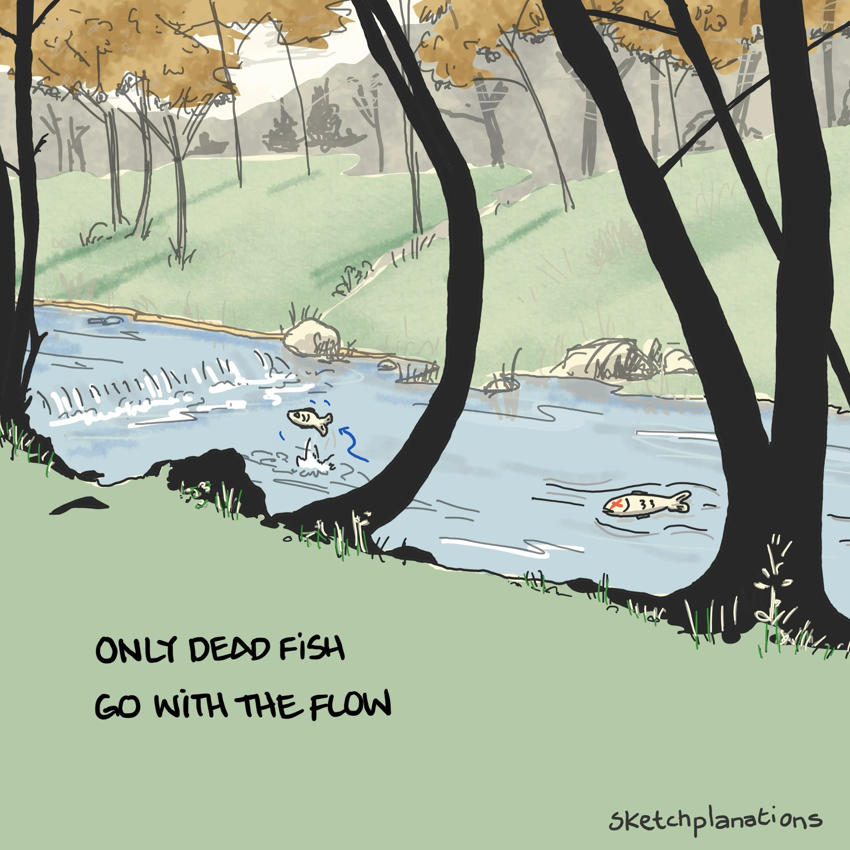

Slide 31
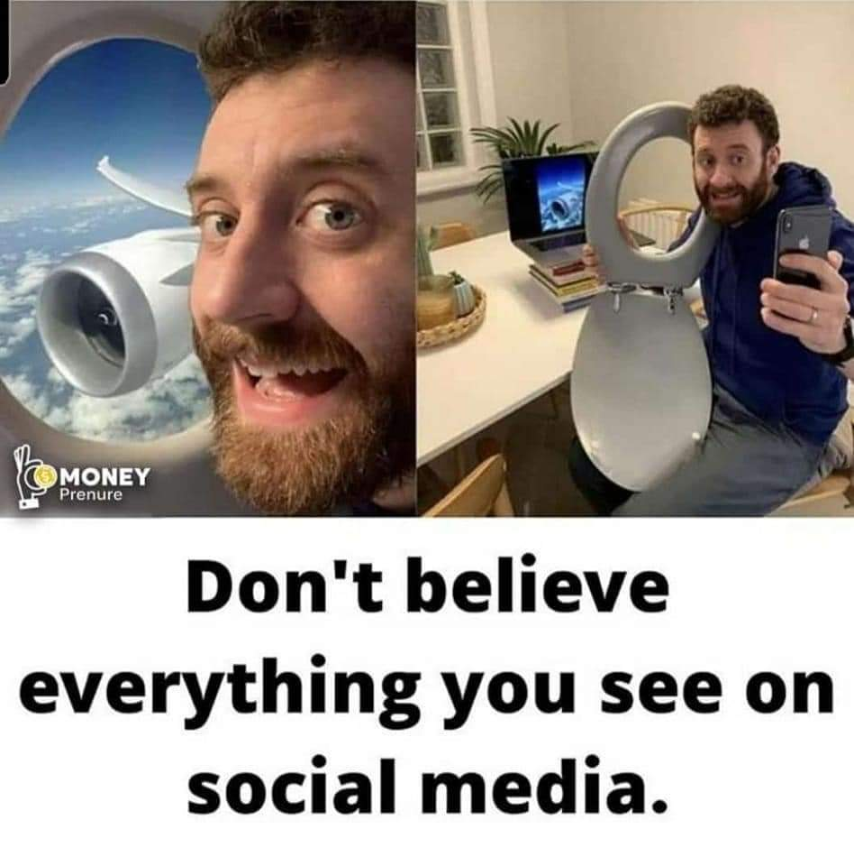

Slide 32
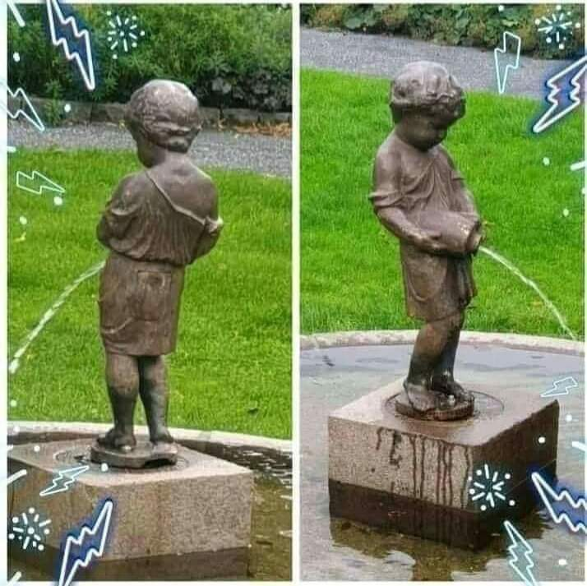

Slide 33
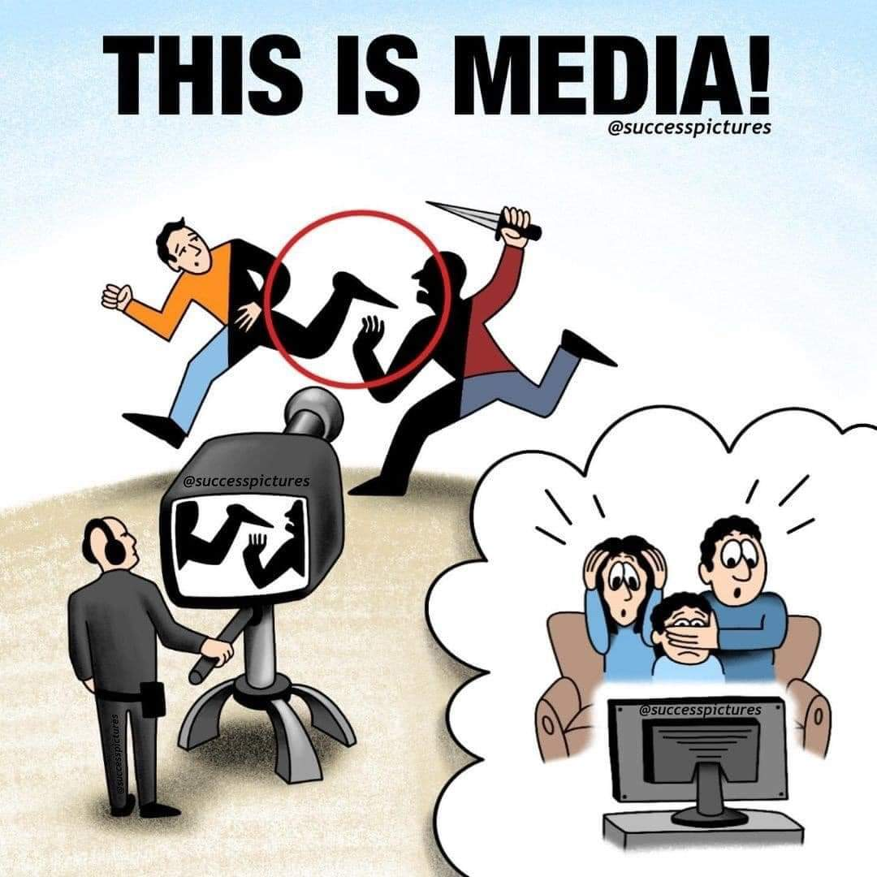

Slide 34
Suggested readings
Danziger, J. N., & Smith, C. A. (2016). Understanding the political world: A comparative introduction to political science. Boston :Pearson, pp. 234-239.
Roskin, M. G., Cord, R. L., Medeiros, J. A., & Jones, W. S. (2016). Political Science: An Introduction (14th Edition). Upper Saddle River: Pearson. (Chapter 07)
Martin HarropWilliam L. Miller (1987). Elections and Voters A comparative introduction; London: Red Globe Press, pp. 130-170.
Different biases: https://www.weforum.org/agenda/2020/08/11-cognitive-biases-that-influence-political-outcomes

Slide 35
Q?

